Slide 1
Data Mining and Machine Learning
Name: Dhruv Vimal Shah
Student ID: x21121087
Course: Data Analytics - Jan 2022, Group-B
Dept. of Computing
National College of Ireland Dublin, Ireland

Slide 2
Datasets Chosen
Dataset 1: Default of Credit Card Clients
Dataset 2: HR Analytics: Employee Promotion Data
Dataset 3: HR Analytics: Job Change of Data Scientists

Slide 3


The research question :
What are the factors that help determine whether an employee will be promoted or not?
What is the probability that a person's future credit card default can be forecasted based on their account information and historical bill payments?
What factors are utilized to determine whether or not an employee is presently searching a new work?

Slide 4
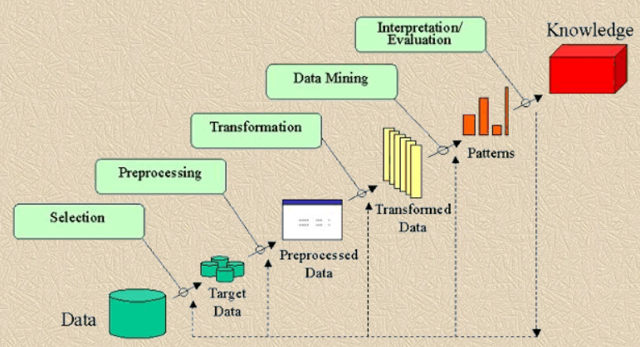
KDD Methodology

Slide 5
Models Used
Dataset 1: KNN, Random Forest Classifier, Logistics Regression
Dataset 2: Logistics Regression Classifier and Gaussian Naïve Bayes
Dataset 3: Random Forest Classifier and Decision Tree Classifier

Slide 6
THANK YOU

